Slide 1



PIZZA
MySQL PROJECT
SALES ANALYSIS
BY : JUI CHAKRABORTY

Slide 2






HELLO!
"I am Jui Chakraborty ,a data analyst. In my role, I 've leveraged SQL queries to analyze Pizza Sales data. With MySQL as my primary tool, I 've addressed various sales-related questions, showcasing my expertise in data analysis and
MySQL proficiency."

Slide 3

RELATED QUESTIONS
Retrieve the total number of orders placed.
Calculate the total revenue generated from pizza sales.
Identify the highest-priced pizza.
Identify the most common pizza size ordered.
List the top 5 most ordered pizza types along with their quantities.
Join the necessary tables to find the total quantity of each pizza category ordered.
Determine the distribution of orders by hour of the day.
Join relevant tables to find the category-wise distribution of pizzas.
Group the orders by date and calculate the average number of pizzas ordered per day. 10.Determine the top 3 most ordered pizza types based on revenue.
Calculate the percentage contribution of each pizza type to total revenue.
Analyze the cumulative revenue generated over time.
Determine the top 3 most ordered pizza types based on revenue for each pizza
category

Slide 4
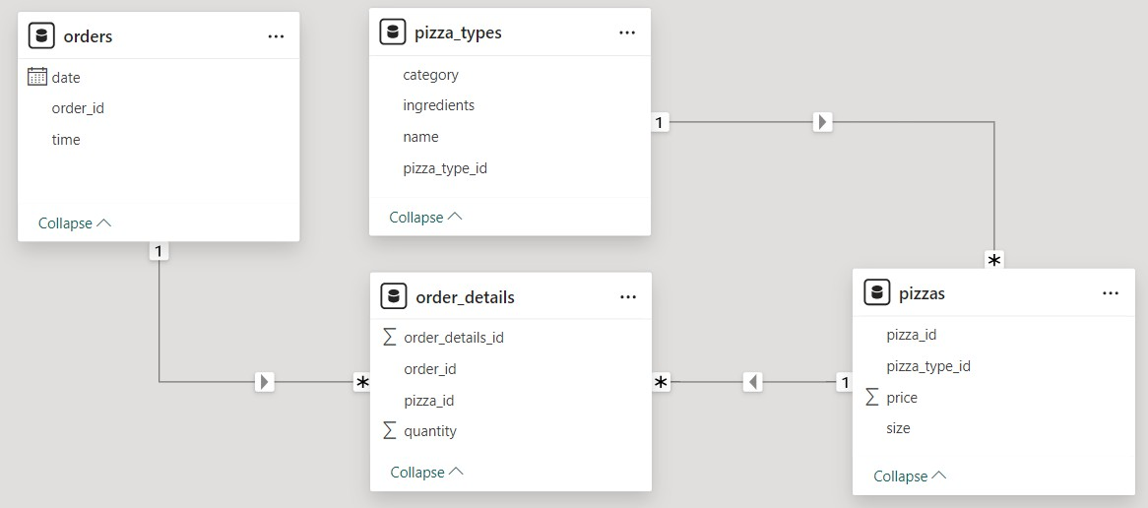
DATA MODEL

Slide 5
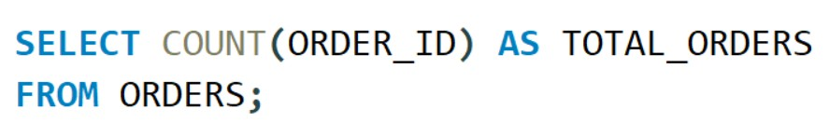

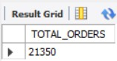
RETRIEVE THE TOTAL NUMBER OF ORDERS PLACED
INPUT
OUTPUT

Slide 6
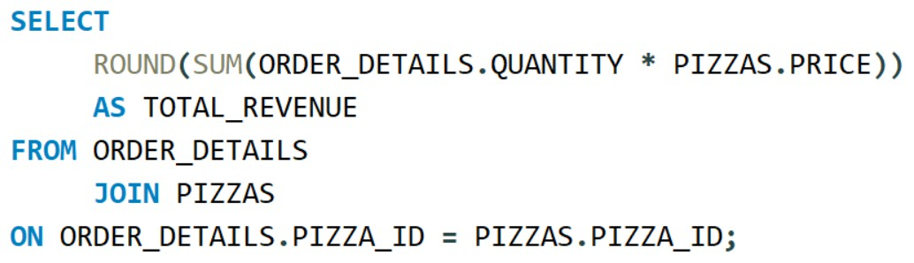
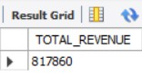
CALCULATE THE TOTAL REVENUE GENERATED FROM PIZZA SALES
INPUT
OUTPUT

Slide 7
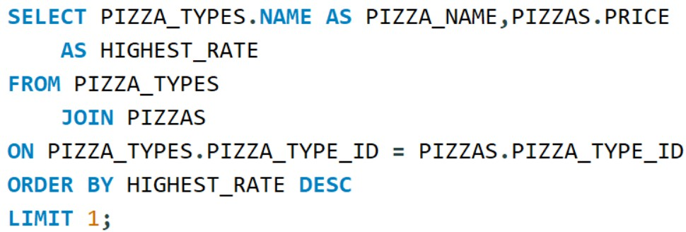
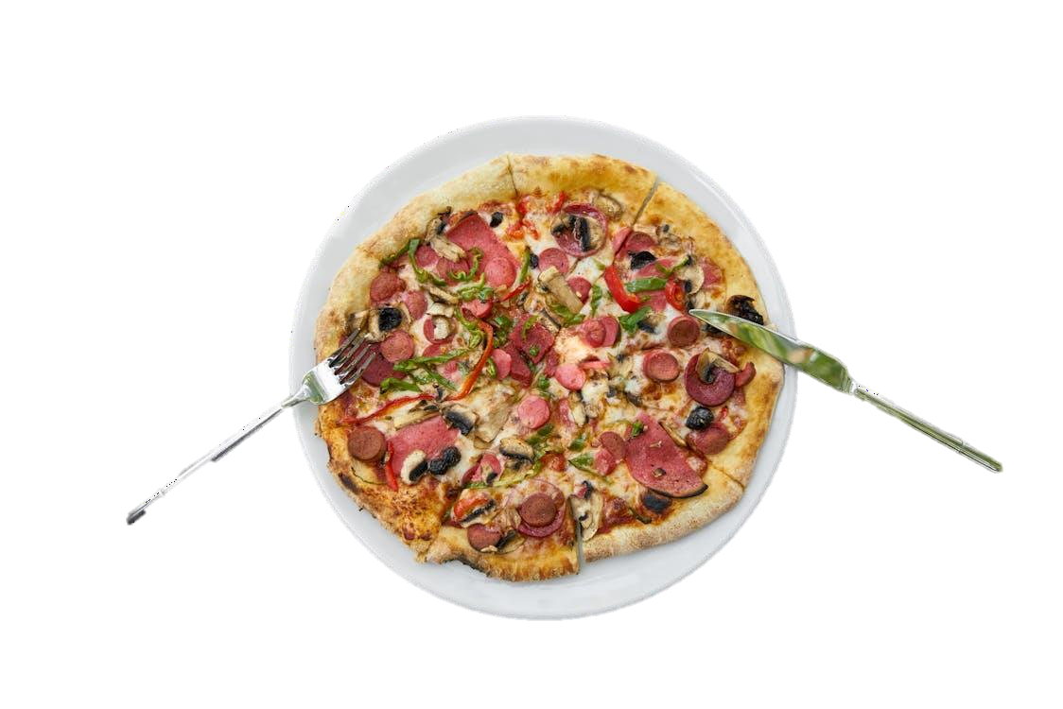
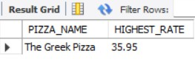
IDENTIFY THE HIGHEST-PRICED PIZZA
INPUT
OUTPUT

Slide 8
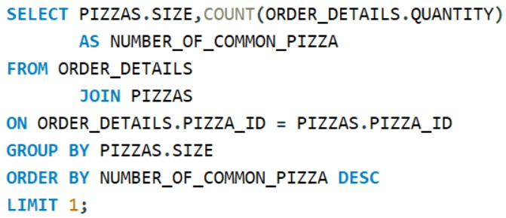
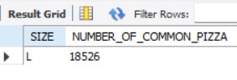
IDENTIFY THE MOST COMMON PIZZA SIZE ORDERED
INPUT
OUTPUT

Slide 9
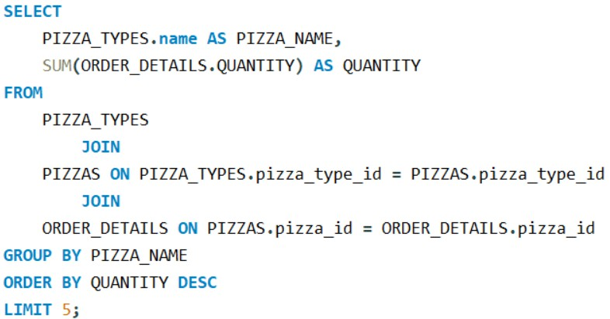
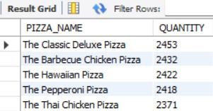
LIST THE TOP 5 MOST ORDERED PIZZA TYPES ALONG WITH THEIR QUANTITIES
OUTPUT
INPUT

Slide 10
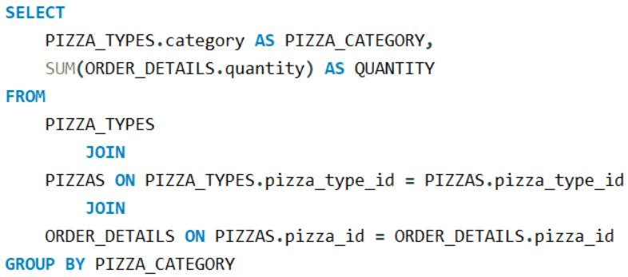
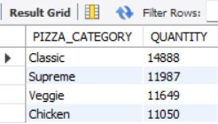
JOIN THE NECESSARY TABLES TO FIND THE TOTAL QUANTITY OF EACH PIZZA CATEGORY ORDERED
OUTPUT
INPUT

Slide 11
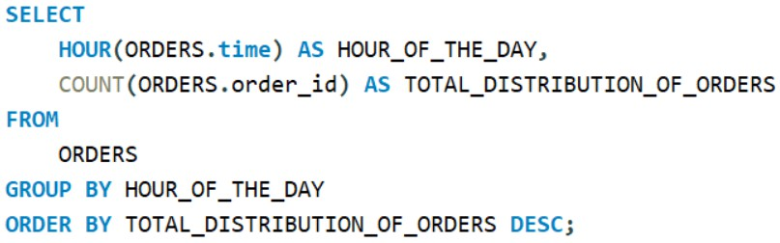
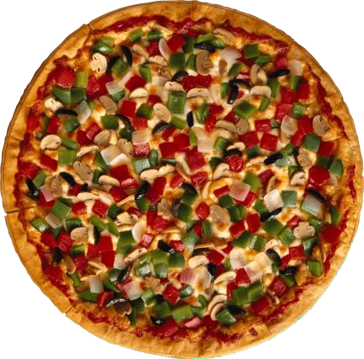
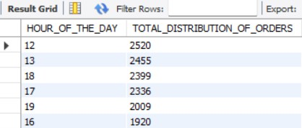
DETERMINE THE DISTRIBUTION OF ORDERS BY HOUR OF THE DAY
INPUT
OUTPUT

Slide 12
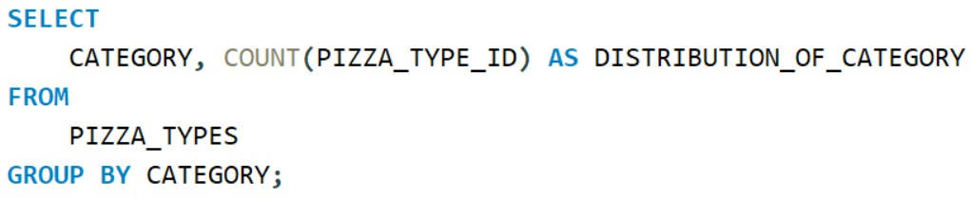
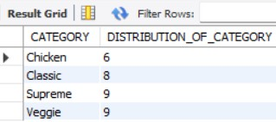
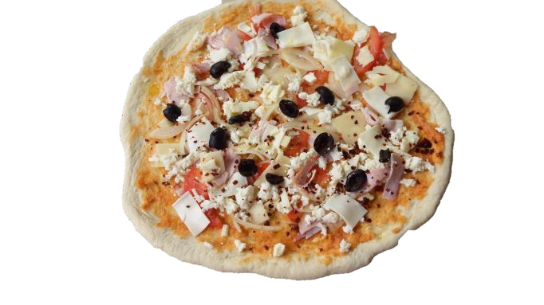
JOIN RELEVANT TABLES TO FIND THE CATEGORY- WISE DISTRIBUTION OF PIZZAS
INPUT
OUTPUT

Slide 13
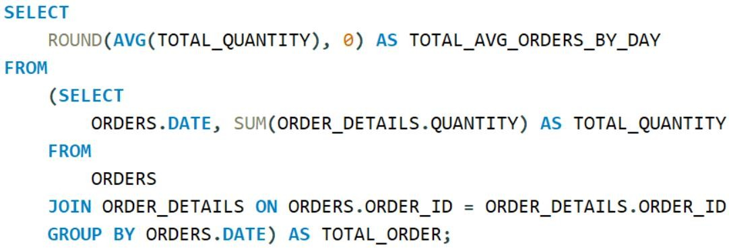
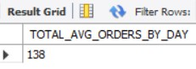
GROUP THE ORDERS BY DATE AND CALCULATE THE AVERAGE NUMBER OF PIZZAS ORDERED PER DAY
INPUT
OUTPUT

Slide 14
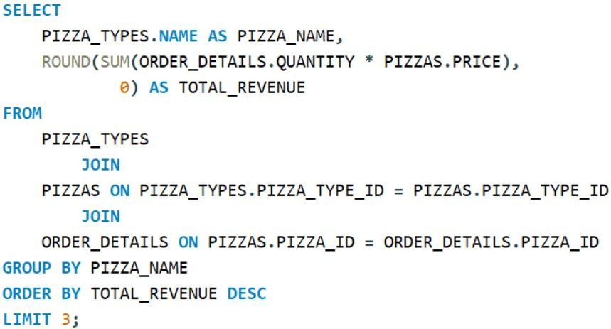
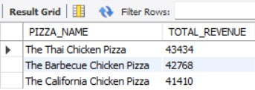

DETERMINE THE TOP 3 MOST ORDERED PIZZA TYPES BASED ON REVENUE
OUTPUT
INPUT

Slide 15
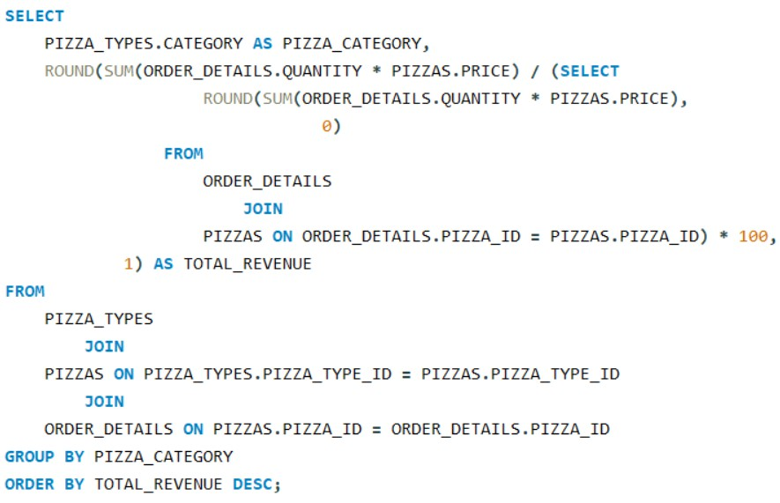
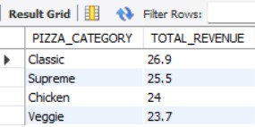
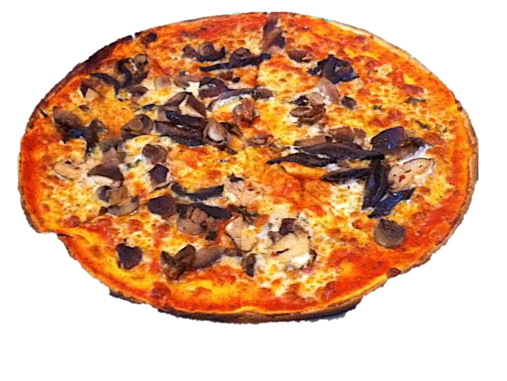
CALCULATE THE PERCENTAGE CONTRIBUTION OF EACH PIZZA TYPE TO TOTAL REVENUE
OUTPUT
INPUT

Slide 16
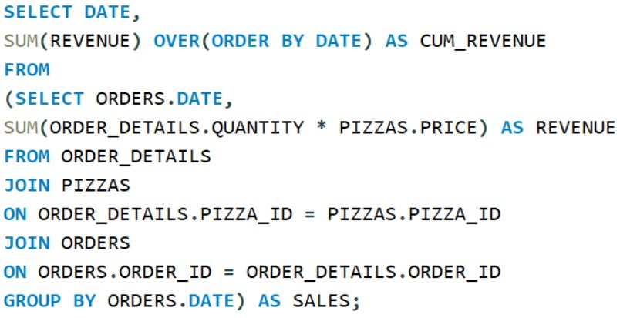
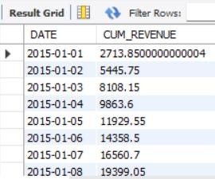
ANALYZE THE CUMULATIVE REVENUE GENERATED OVER TIME
OUTPUT
INPUT

Slide 17
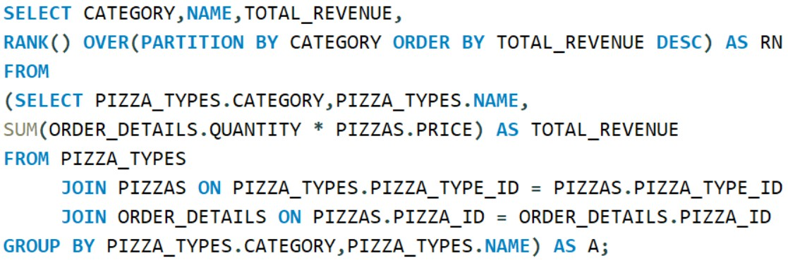

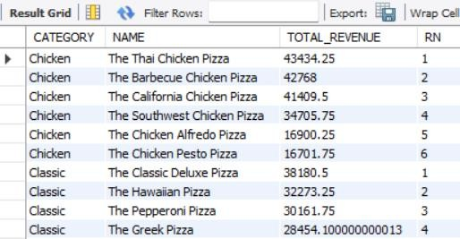
ANALYZE THE CUMULATIVE REVENUE GENERATED OVER TIME
INPUT
OUTPUT

Slide 18


CONCLUSION
"In conclusion, the Pizza Sales MySQL project has been a rewarding endeavor, showcasing the power of data analysis in uncovering valuable insights. Leveraging MySQL, we've efficiently managed and manipulated large datasets, facilitating informed decision-making for stakeholders. The project highlights the importance of data-driven strategies in optimizing sales performance and enhancing customer satisfaction. Moving forward, the insights gleaned from this project will serve as a foundation for refining marketing strategies, improving operational efficiency, and driving business growth in the competitive pizza industry."

Slide 19


THANK YOU

